Slide 1
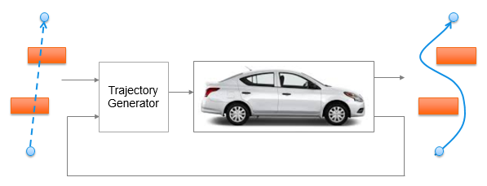
Trajectory Generation in High Density Environment
Mid-Term Review
Suvo Ganguli
Alberto Speranzon
Mar 2018

Slide 2
Overview
Trajectory Generation in 2-dimensional space
Laplacian Planner
Model Predictive Control (MPC)
Tradeoff Parameters
Tradeoff Data and Charts
Summary

Slide 3
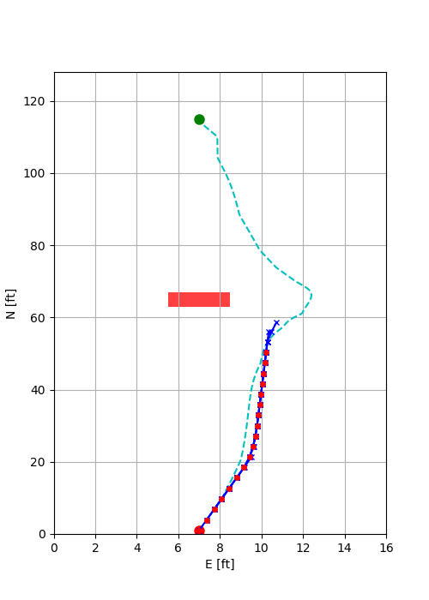
Trajectory Generation
There are two steps to the trajectory generation:
Laplacian Planner Trajectory Generation
Solves for a potential flow from start point to end point avoiding obstacles
Does not take into account vehicle dynamics and constraints
Provides an initial solution for the MPC Trajectory Generator
MPC Trajectory Generation
Solves an optimization problem to generate a short trajectory
Moves one step along the trajectory and resolves the optimization problem
Takes into account vehicle dynamics and constraints

Slide 4
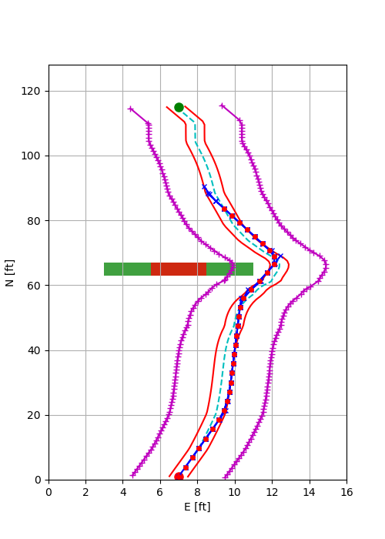
MPC Trajectory Generation
Minimize cost
Velocity error
Lateral path error
Control signals
Satisfy vehicle dynamics and constraints
Satisfy other constraints
Trajectory constraints
Terminal constraints
Lateral Acceleration constraint
Laplacian trajectory
Terminal constraints
Obstacle
Safety Margin
Trajectory constraints
MPC trajectory

Slide 5
Overview
Trajectory Generation in 2-dimensional space
Laplacian Planner
Model Predictive Control (MPC)
Tradeoff Parameters
Tradeoff Data and Charts
Summary

Slide 6
Tradeoff Parameters
Our goal is to trade off the CPU time (CT) with
Trajectory Parameters
Number of MPC time steps = N
MPC time step = T
Model Complexity
Number of states = ns
Obstacle density
Number of obstacles = no
Model Complexity
4 state model
6 state model
Obstacle Density is measured by the number of obstacles which are
Static
Placed to obstruct the line of sight from the start point to the end point
CT
vs
N | T (sec) | ns | no
4 | 0.2 | 4 | 0
6 | 0.4 | 6 | 1
8 |  |  | 2
10

Slide 7
Model Complexity
4 state model
6 state model

Slide 8
Overview
Trajectory Generation in 2-dimensional space
Laplacian Planner
Model Predictive Control (MPC)
Tradeoff Parameters
Tradeoff Data and Charts
CPU time vs Number of Time Steps (CT vs N)
CPU time vs Number of Obstacles (CT vs no)
CPU time vs Number of States (CT vs ns)
CPU time vs Time Step (CT vs T)
Summary

Slide 9
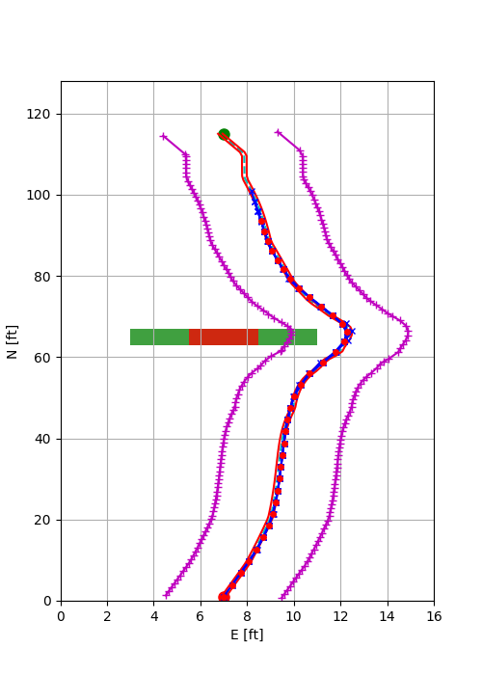
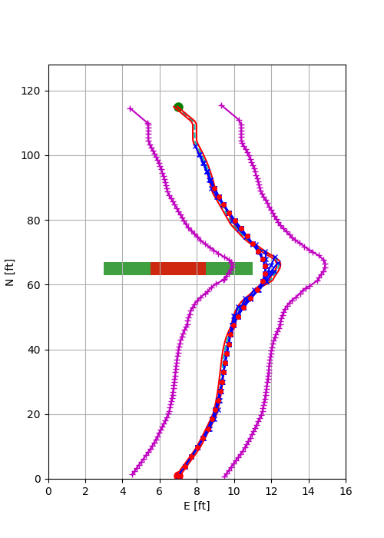
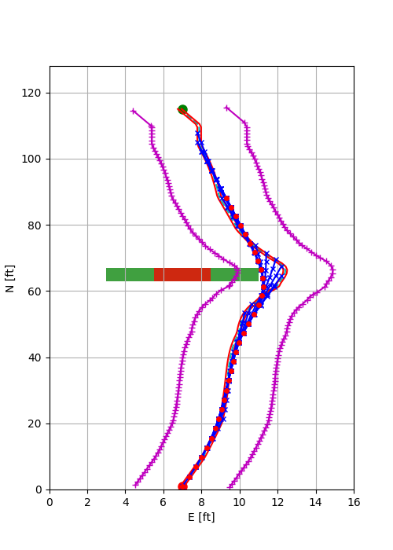
Trajectory Variation with No. of Time Steps
With number of states = 4 and number of obstacles = 1, as we increase the number of time steps = 4, 6, 8, we observe that the trajectory gets smoother
If a “ribbon” being pulled along a circuitous path, the longer the ribbon, the wider the turns.
N = 4
N = 6
N = 8

Slide 10
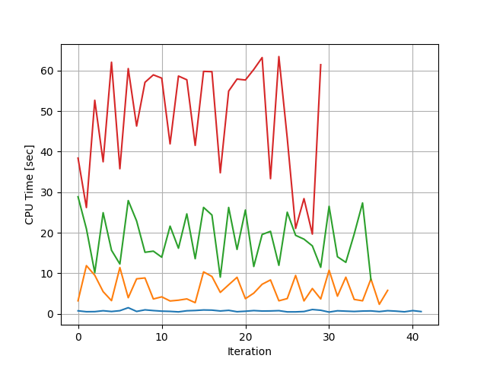
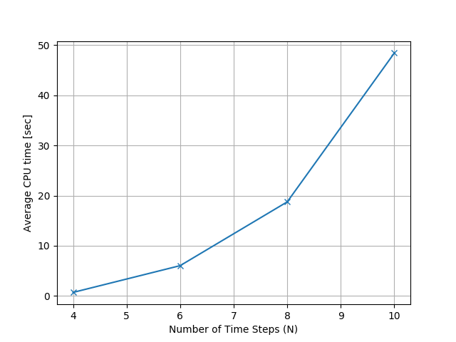
CPU Time vs No. of Time Steps (CT vs N)
CPU mean time increases with N as 2^{N}
N=10
N=8
N=6
N=4

Slide 11
Overview
Trajectory Generation in 2-dimensional space
Laplacian Planner
Model Predictive Control (MPC)
Tradeoff Parameters
Tradeoff Data and Charts
CPU time vs Number of Obstacles (CT vs N)
CPU time vs Number of Obstacles (CT vs no)
CPU time vs Number of Time Steps (CT vs ns)
CPU time vs Time Step (CT vs T)
Summary

Slide 12
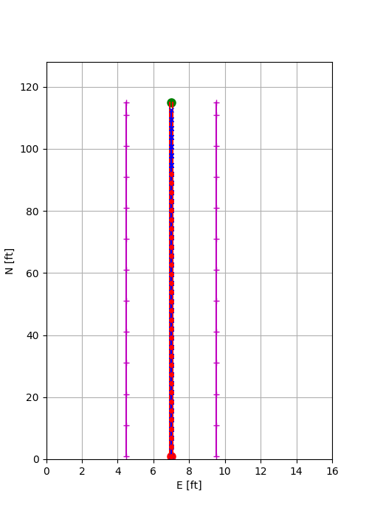
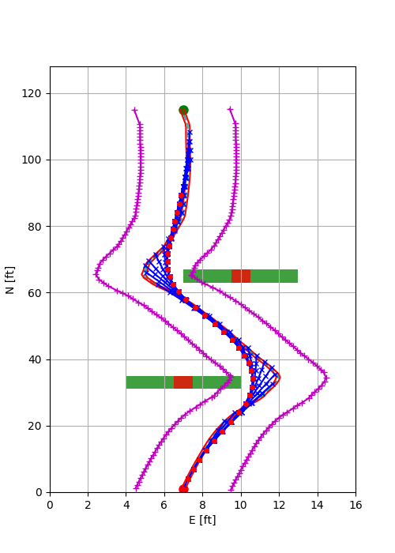
MPC Trajectory in Presence of Obstacles
MPC Trajectory Generator successfully generates path between the start and end point in presence of obstacles
N = 8, T = 0.4, ns = 4
No Obstacle
1 Obstacle
2 Obstacles

Slide 13
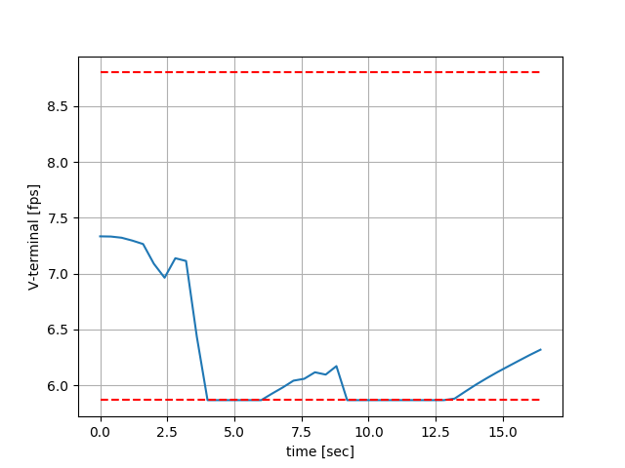
MPC Trajectory Satisfies Vehicle Constraints
Vehicle has a tendency of slowing down during the turns.
MPC constraints prevents the vehicle to slow down too much
N = 4, T = 0.4, ns = 4, no = 2
Corresponds to the turns to avoid the two obstacles

Slide 14
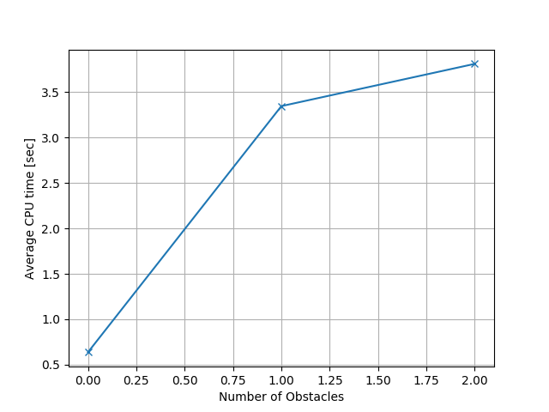
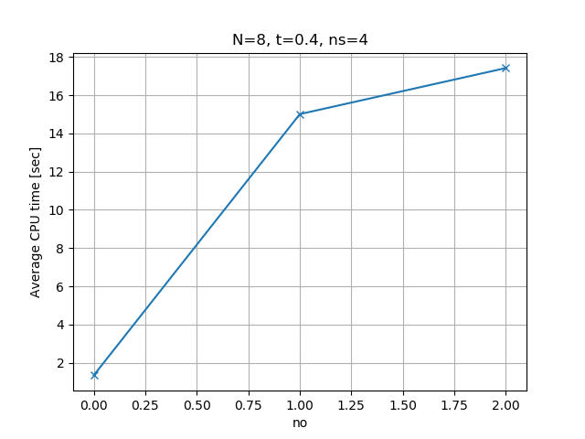
CPU Time vs Number of Obstacles (CT vs no)
Average CPU time increases with the number of obstacles
The increase exponentially decays with increase in number of obstacles
9x
11x

Slide 15
Overview
Trajectory Generation in 2-dimensional space
Laplacian Planner
Model Predictive Control (MPC)
Tradeoff Parameters
Tradeoff Data and Charts
CPU time vs Number of Time Steps (CT vs N)
CPU time vs Number of Obstacles (CT vs no)
CPU time vs Number of States (CT vs ns)
CPU time vs Time Step (CT vs T)
Summary

Slide 16
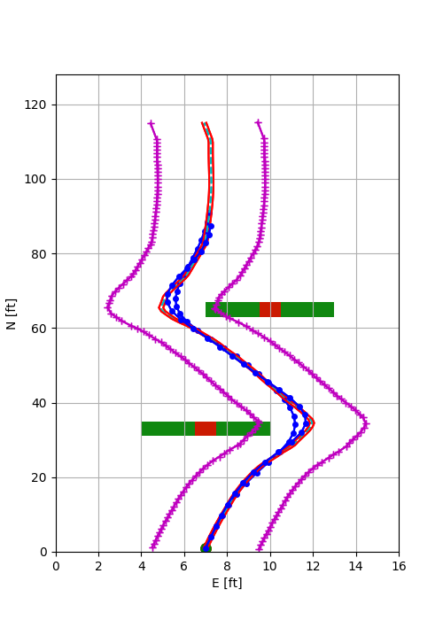
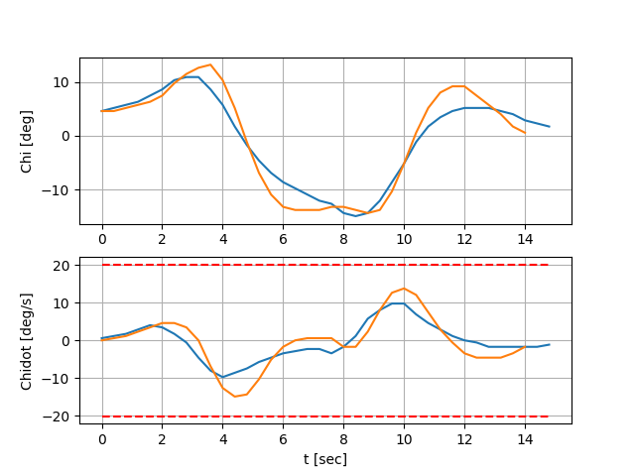
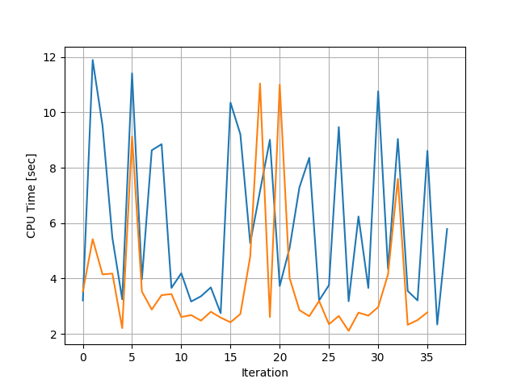
Number of Solver Iterations
CT for ns = 6 takes less time than ns = 4 (counter-intuitive)
For ns = 6, the control reacts faster as the derivative of the acceleration is controlled
Hence it takes less computation since the change in lateral position of the terminal point is easier to control
The resultant path is smoother for ns = 6 as the control is more effective
ns=4
ns=6
ns=4
ns=6
ns=4
ns=6
(smoother)

Slide 17
Overview
Trajectory Generation in 2-dimensional space
Laplacian Planner
Model Predictive Control (MPC)
Tradeoff Parameters
Tradeoff Data and Charts
CPU time vs Number of Time Steps (CT vs N)
CPU time vs Number of Obstacles (CT vs no)
CPU time vs Number of States (CT vs ns)
CPU time vs Time Step (CT vs T)
Summary

Slide 18
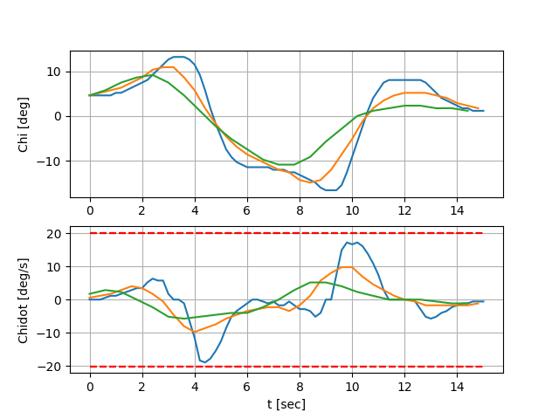
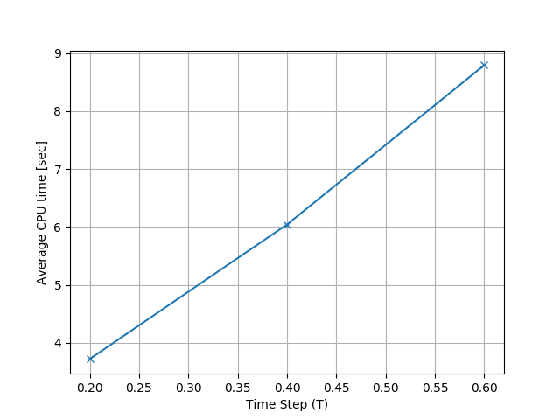
CPU Time vs Time Step (CT vs T)
Need to rethink
Computation time increases linearly with increase in T
This is similar to variation with respect to N
The trajectory smoothness increases and the control effect decreased with increase in T. This is because with increase in horizon distance, the control action can be taken earlier

Slide 19
Quick Recap
CPU Time (CT) variation with the tradeoff parameters – number of trajectory steps (N), number of obstacles (no) and number of states (ns) are as follows:
CT increases with N as 2^{N}
CT increases with no as e^{-no}
CT decreased from ns = 4 to ns = 6
CT increases linearly with T

Slide 20
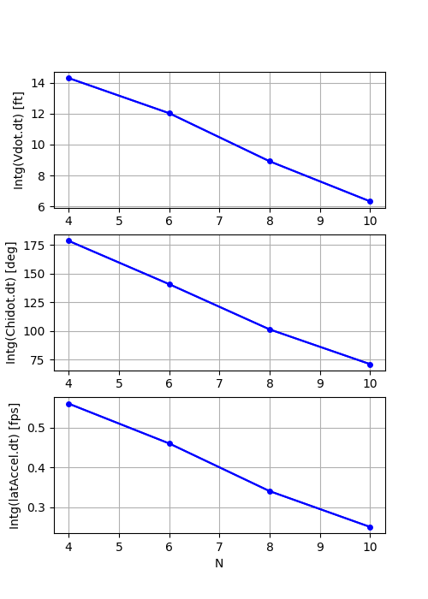
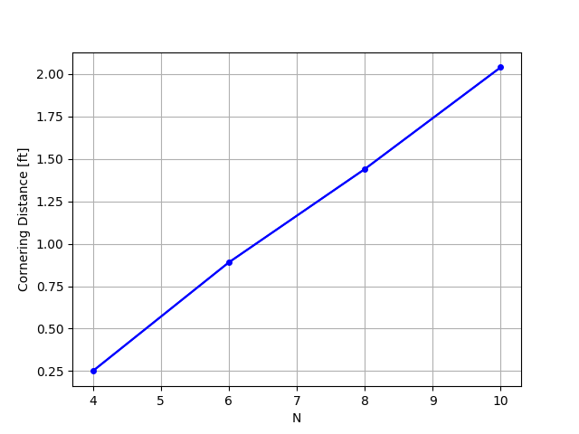
Tradeoff Curves for Design – 1 of 2
Increase in N (equivalent to horizon distance) leads to:
Smoother trajectory
Increase in comfort level
Decrease in control effort
At the cost of
Increase in computation time
Control Effort
Computation time
Trajectory Smoothness
Control Effort
1
Comfort Level

Slide 21
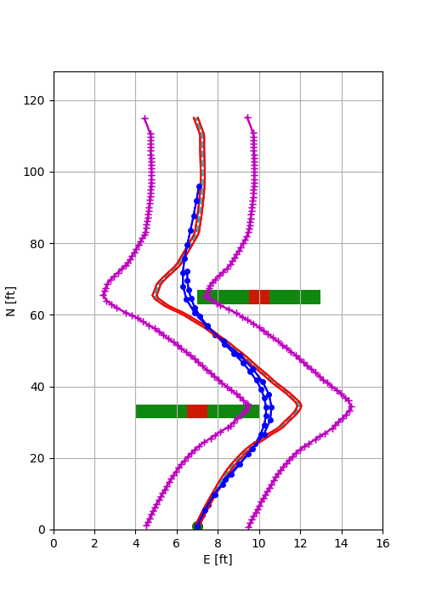
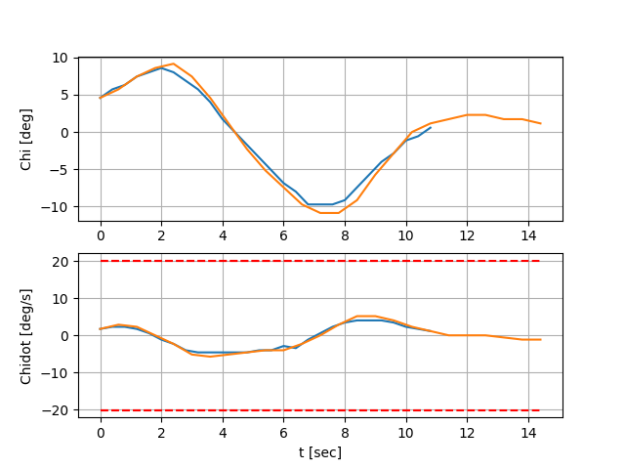
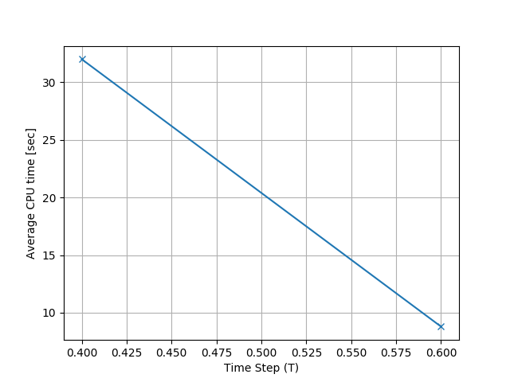
Tradeoff Curves for Design – 2 of 2
The same horizon length can be formed with different combinations of N and T – for e.g., (N = 9, T = 0.4) vs (N = 6, T = 0.6)
Plots below show that control effort and the trajectory smoothness are similar. However the Computation Time is 4X more for (N = 9, T = 0.4)
N=6, T = 0.6
N=9, T = 0.4
4X
N=9, T = 0.4
N=6, T = 0.6

Slide 22
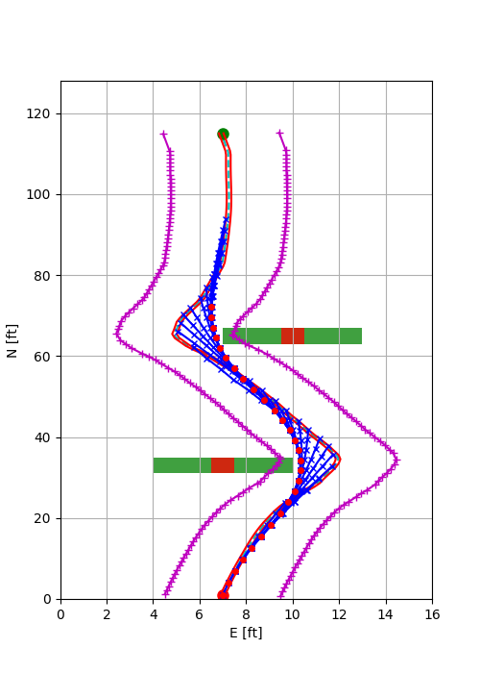
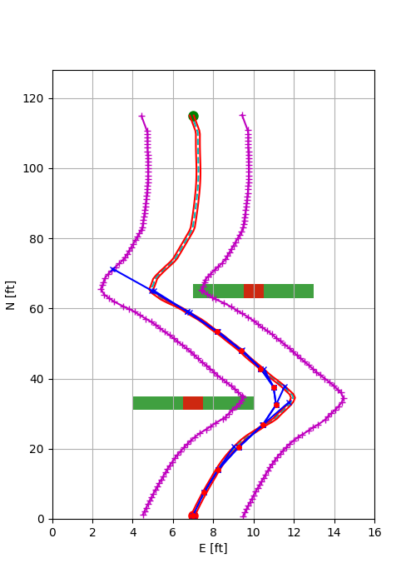
Tradeoff Curves for Design – 2 of 2
Too large a time step can lead to infeasible solution as the required heading change can be large and the solution for the nonlinear optimization cannot be guaranteed
(N = 9, T = 0.4)
(N = 4, T = 0.9)
requires large heading change
requires small heading change

Slide 23
Summary
CPU Time (CT) variation with the tradeoff parameters – number of trajectory steps (N), number of obstacles (no) and number of states (ns) are as follows:
CT increases with N as 2^{N}
CT increases with no as e^{-no}
CT decreased from ns = 4 to ns = 6
CT increases linearly with T
Increase in horizon distance leads to:
Smoother trajectory
Increase in comfort level
Decrease in control effort
This is because with increase in horizon distance, control action can be taken earlier.
This is at the cost of increase in computation time (CT)

